Slide 1
CUSTOMER CHURN ANALYSIS
|
( Telecommunication )

Slide 2
Introduction
Customer churn analysis is a vital process that helps businesses understand why customers discontinue using their products or services. This is especially critical in the highly competitive telecom industry, where retaining customers can significantly impact profitability.
What is a Customer?
A customer is an individual or organization that purchases goods or services from a company.
What is a Churn?
Churn refers to the phenomenon where customers stop using a company's products or services

Slide 3
Objectives
Primary
Secondary
Analyze customer churn in the telecom industry and understand contributing factors.
Churn Rate: Measure the percentage of customers who have left over a specific period.
Examine the impact of pricing, service reliability, and accessibility on churn.
Identify patterns in customer behavior and provide actionable insights to reduce churn rates.

Slide 4
ABOUT DATA
The Telco customer churn data contains information about a fictional telco company that provided home phone and Internet services to 7044 customers in California in Q3. It indicates which customers have left, stayed, or signed up for their service.
Dataset Name: Telecommunications Industry Sample Data
Industry: Telecommunication
Author/creator: IBM
Creation Date: April 5, 2023
Tables:
Population: Population count zip code wise.
Services: Details on customer subscriptions, revenues and internet type
Status: Satisfaction score, churn status, reasons.
Demographics: Gender and dependents
Location: Country, state, city, latitude and longitude

Slide 5
Data Pre Processing & Cleaning
Step 1
Step 2
Step 3
Step 4
Data Import
Data Cleaning
Data Merging
Data Transformation
Removed duplicates
Filled null values with appropriate replacements
Fixed data types
Dropped unnecessary columns
Merged multiple tables into a single dataset
Removed redundant columns
Removed high-cardinality (unique) columns
Encoded categorical column
Loading dataset into a DataFrame using Pandas

Slide 6
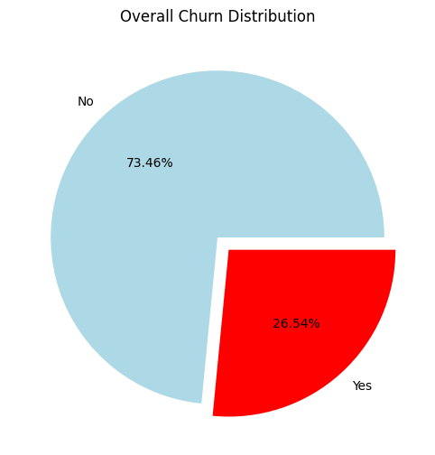
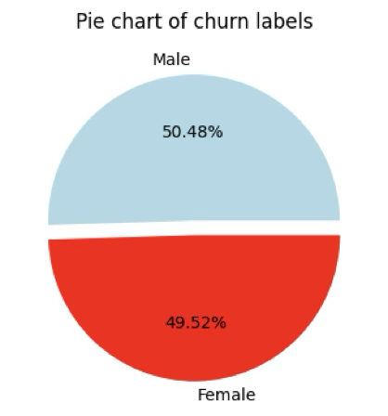
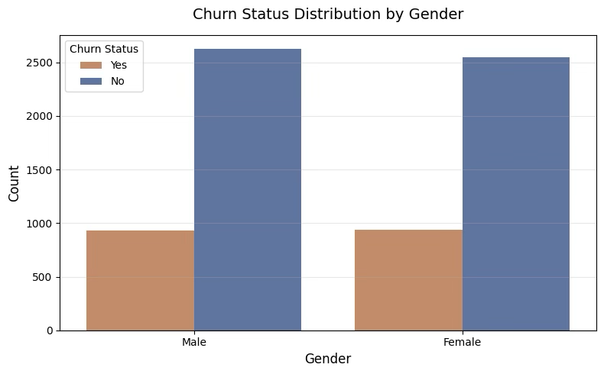
Initial
Analysis

Slide 7
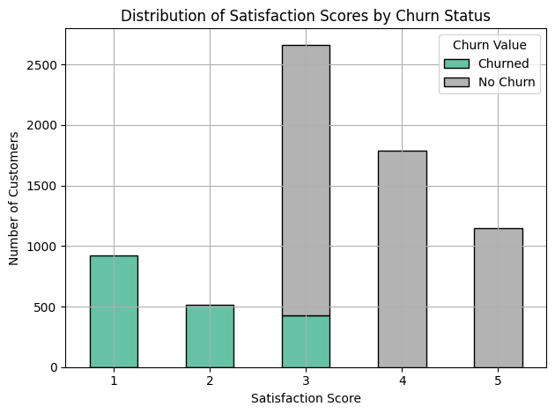
QUESTION
Q1. Churn Status vs. Customer Satisfaction How does the churn status vary with customer satisfaction scores ?
Key Insights:
Low Satisfaction (Scores 1-2): Almost every customer in this group churned, indicating an exceptionally high churn risk.
High Satisfaction (Scores 4-5): No churn observed — these scores are highly predictive of customer retention.
Mid Satisfaction (Score 3): Acts as a tipping point — majority retained, but a noticeable minority still churned.
Overall: Satisfaction Score is a highly reliable predictor of churn behavior in this dataset.

Slide 8
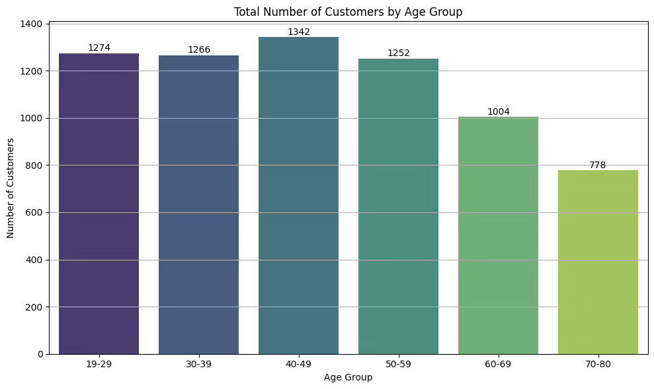
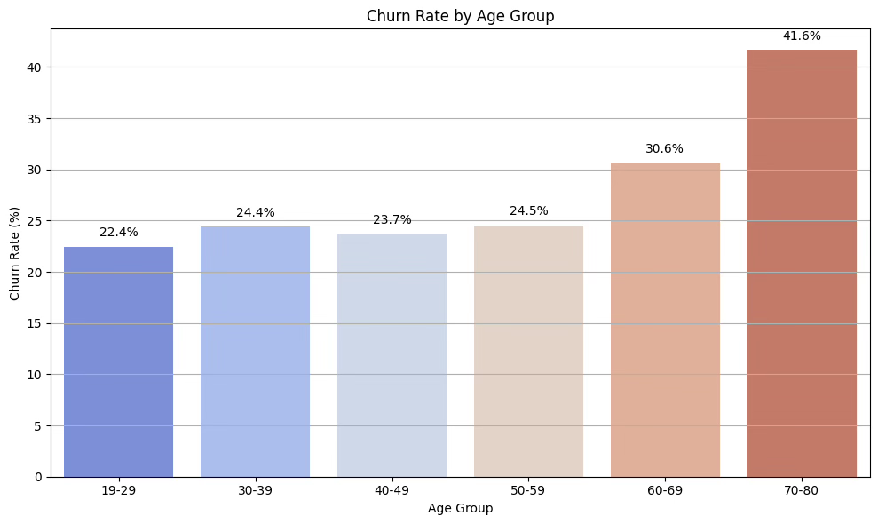
QUESTION
Q2. Churn Rate vs. Seniority
How does the churn rate vary with customer seniority?
Key Insights:
Age (Seniority): Churn rates increase notably for customers over 60 years old. While most customers fall within the 19–59 age range, older customers show a higher churn risk, indicating the need for targeted retention strategies for the 60+ segment.

Slide 9
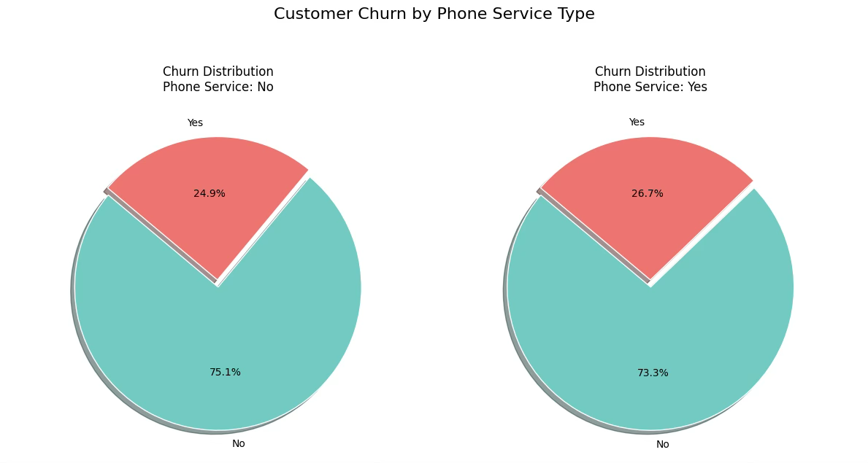
QUESTION
Q3. Churn Rate vs. Phone Services
How does the churn status vary with phone service type?
Key Insights:
Phone Service: Churn rates are fairly similar for customers with and without phone service, with a slightly higher churn observed among those with phone service. This suggests phone service alone is not a significant churn driver.

Slide 10
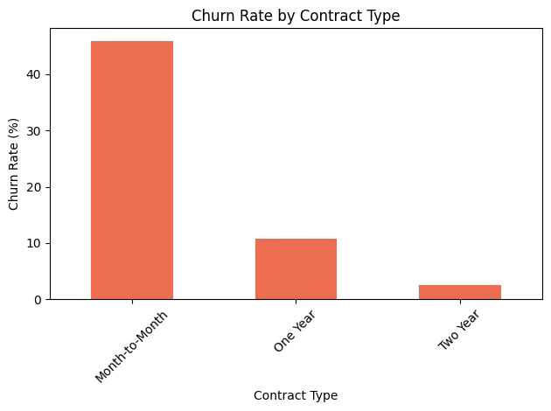
QUESTION
Q4. Churn Rate vs. Contract Type
How does the churn status vary with contract type?
Key Insights:
Contract Type: There’s a strong negative relationship between contract length and churn. Customers on Month-to-Month plans churn far more than those on annual or biennial contracts. Longer-term contracts are a key driver of customer loyalty.

Slide 11
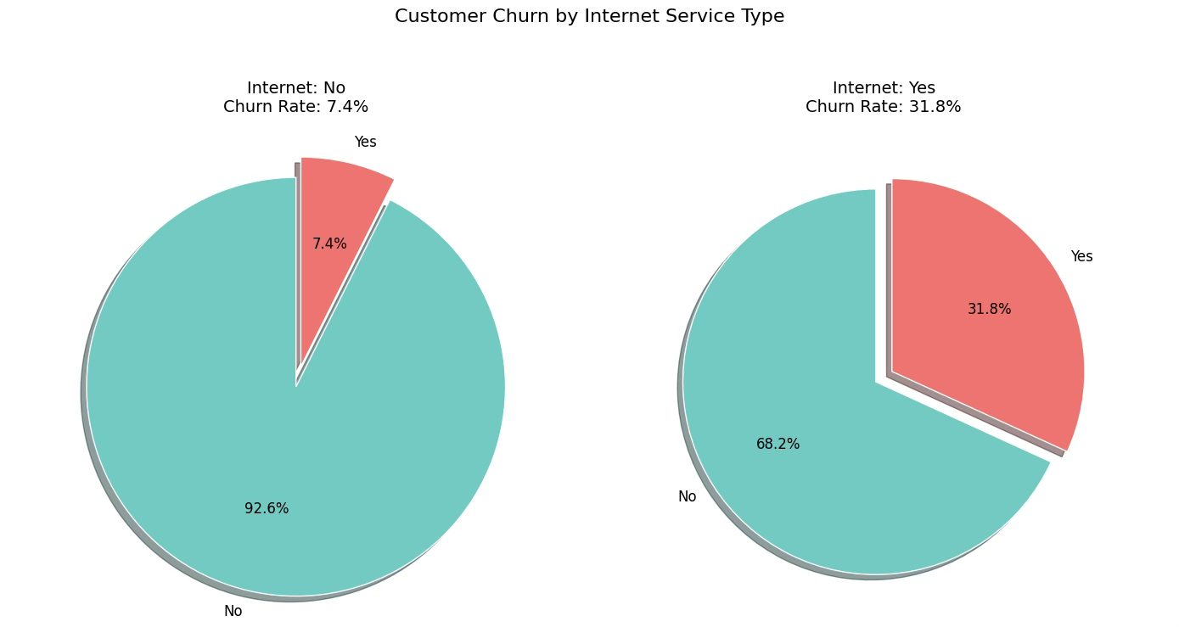
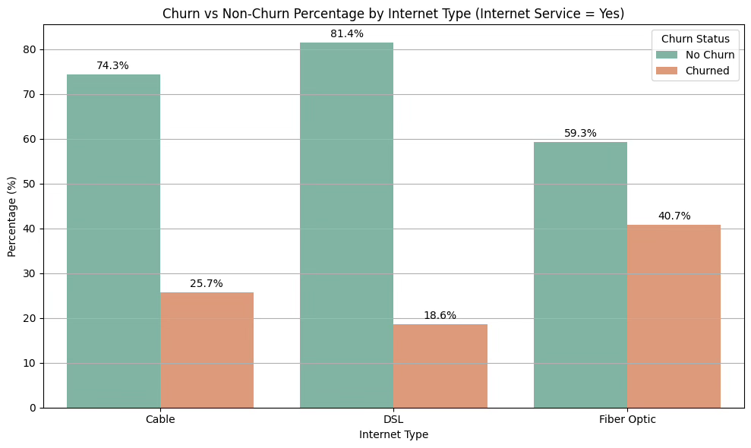
QUESTION
Key Insights:
Fiber Optic customers have the highest churn rate at 40.7%, suggesting potential issues with cost, reliability, or customer expectations.
DSL customers show the lowest churn rate at 18.6%, indicating stronger stability and satisfaction within this group.
Cable customers’ churn rate falls in between DSL and Fiber Optic.
The high overall churn among internet service subscribers is disproportionately driven by Fiber Optic users.
Recommendation:
Prioritize investigating and addressing the causes of churn among Fiber Optic customers to improve overall retention within the internet service segment.
Q5. Churn Rate vs. Internet Service Type
Which internet service type (e.g., DSL, Fiber Optic) has the highest churn rate?

Slide 12
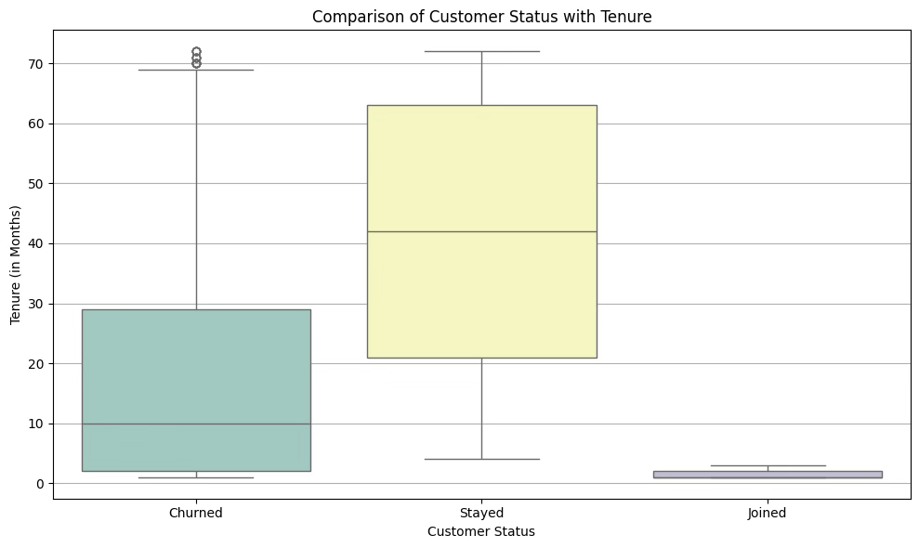
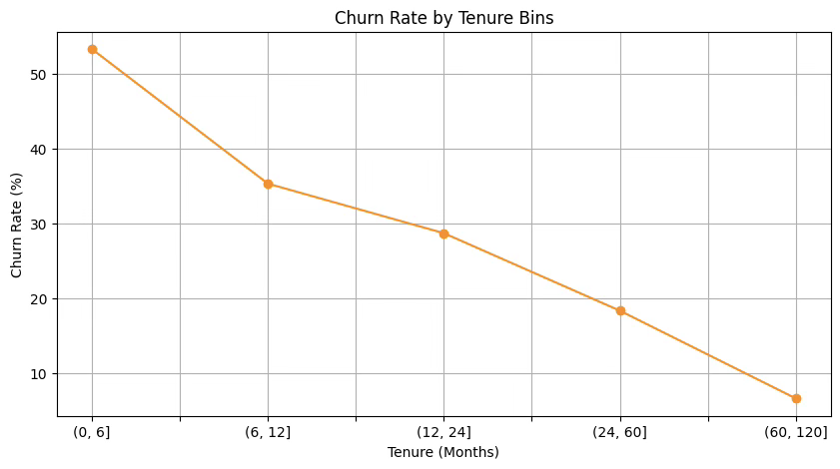
QUESTION
Q6. Churn Rate vs. Customer Tenure
What is the correlation between customer tenure and churn rate?
Key Insights:
Customer tenure is a strong predictor of retention: New customers, have the highest churn risk.
Loyalty increases significantly over time: Long-tenured customers exhibit low churn rates and are the most loyal.
Recommendation:
Focus retention efforts on new customers and, while continuing to support long-tenured customers.

Slide 13
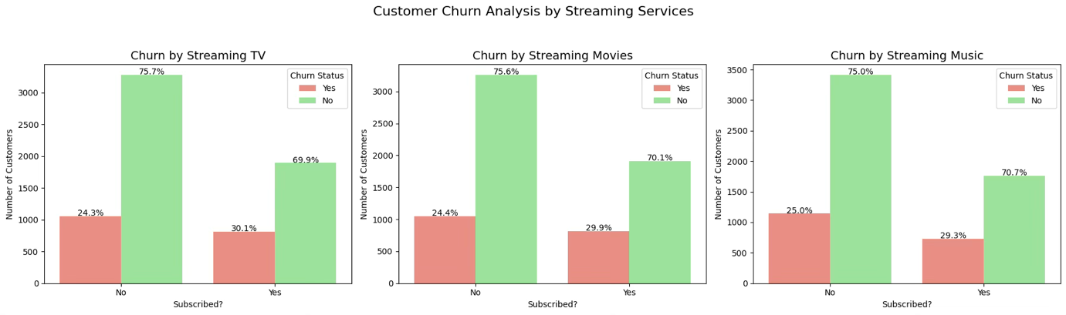
QUESTION
Q7. Churn Status vs. Streaming Service Usage
Are people who use streaming services like TV, movies, or music more likely to churn or not?
Key Insights:
Streaming service users (TV, movies, music) are more likely to churn.
Possible reasons for this trend include customers not finding value, customers switching for companies providing these services bundled with their plans.
Recommendation:
Consider offering bundled streaming services or value-driven incentives to reduce churn.

Slide 14
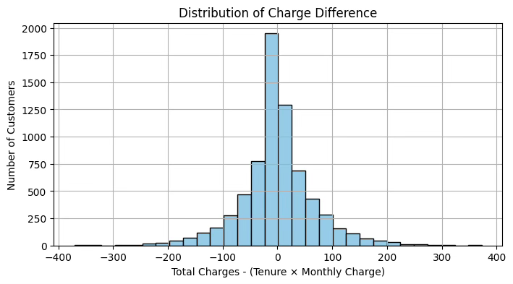
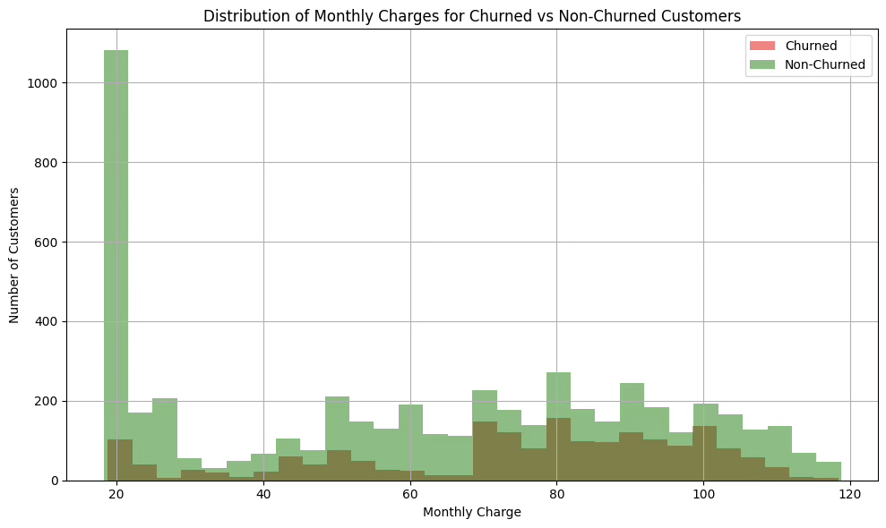
QUESTION
Key Insights:
Churned customers have a significantly higher average monthly charge of $74.44 compared to $61.27 for non-churned customers.
Statistical analysis (T-test) shows that the difference in monthly charges is statistically significant (p-value = 2.7e-60).
Churned customers are spread across higher charge ranges, while non-churned customers tend to be clustered around lower charges (~$20).
Higher monthly charges appear to be a strong indicator of churn.
Recommendation:
Review pricing structures for higher-paying customers and consider designing targeted retention strategies for them.
Investigate whether higher charges are aligned with the value delivered to these customers or if service issues are contributing to churn.
Q8. Churn Status vs. Average Monthly Charges
Is there a significant difference in the average monthly charges between churned and non-churned customers?

Slide 15
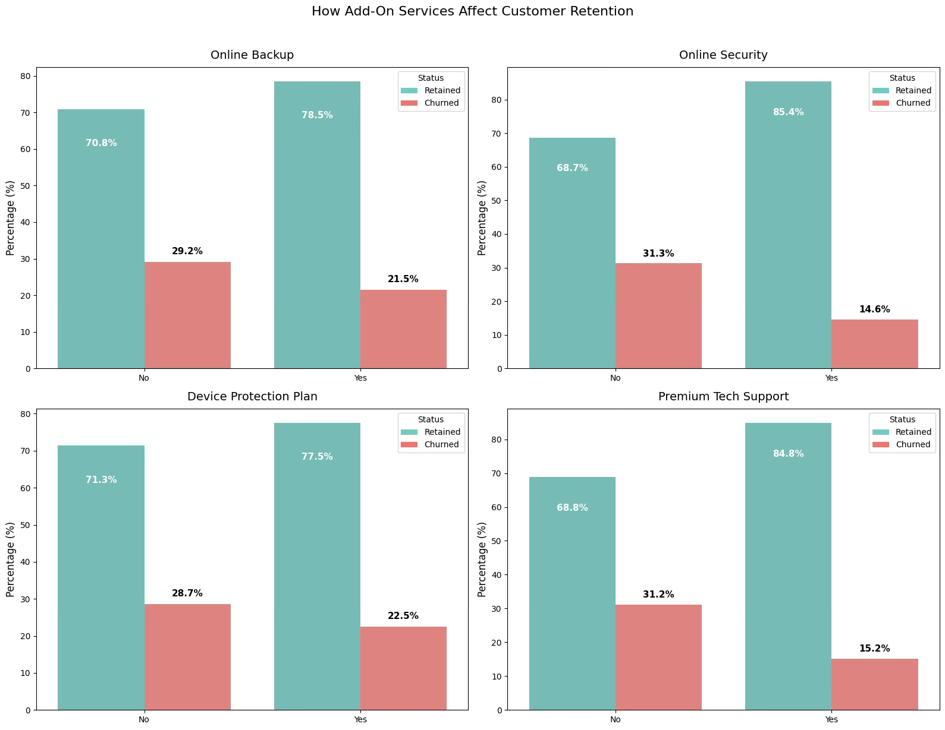
QUESTION
Key Insights:
Customers who have subscribed to the add-on services are less likely to churn.
Online Security and Premium Tech Support are strongly associated with higher retention.
Device Protection and Online Backup, which have less impact on retention.
The lack of adoption of key value-added services (especially Online Security and Premium Tech Support) is a characteristic of customers who are most likely to churn.
Recommendation:
Encourage adoption of Online Security and Premium Tech Support among at-risk customers to boost retention.
Q9. Churned Customers vs. Add-On Services
Which is the relationship between add-on services and churn?

Slide 16
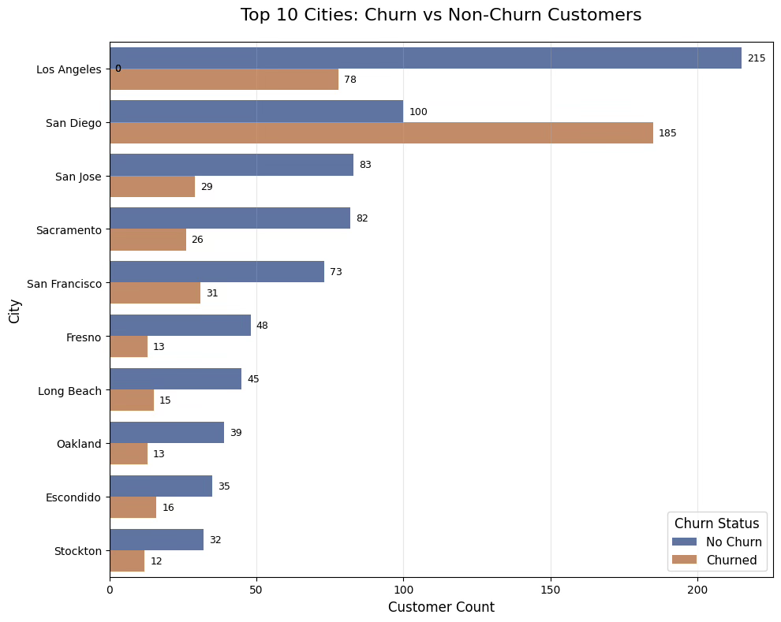
QUESTION
Key Insights:
Churn rates vary significantly by city, with most top cities retaining more customers than they lose.
San Diego and Escondido stand out with higher churn rates relative to non-churned customers, indicating these cities face greater churn challenges.
Geographic location appears to be a significant factor influencing churn, suggesting that local market conditions, service coverage, or demographics may be contributing to these higher churn rates.
Recommendation:
Investigate San Diego and Escondido for potential geographic factors influencing churn, such as market competition or service issues, and develop localized retention strategies.
Q10. Churn Status vs. City/Location
Are there any specific cities or locations more likely to churn?

Slide 17
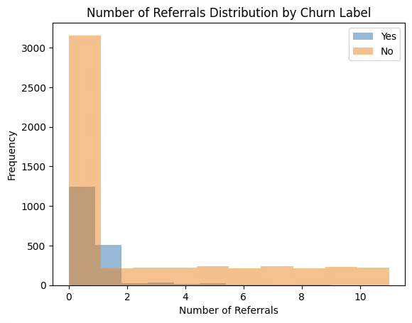
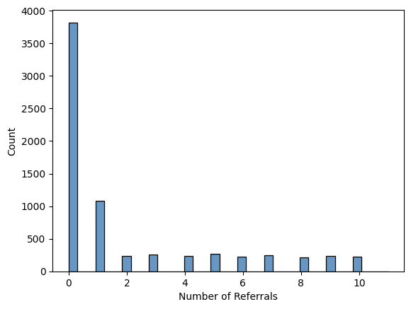
QUESTION
Key Insights:
Referral activity is strongly linked to customer retention.
The largest group of both retained and churned customers made 0 referrals.
However, retained customers are much more likely to make 1 or more referrals (especially 2+), with nearly all customers making 2+ referrals being retained.
Churned customers rarely participate in the referral program beyond zero or one referral.
Recommendation:
Leverage referral programs as a strong loyalty indicator. Consider incentivizing referrals to enhance retention, especially for customers making fewer or no referrals.
Q11. Churn Status vs. Referral Behavior
Are people who refer a friend more or less likely to churn?

Slide 18
Key Suggestions
Marketing & Sales Team: Focus Areas
Targeted offers (e.g., bundles, loyalty programs, time-limited discounts) could re-engage inactive users.
Personalized pricing based on usage and engagement may improve retention.
Early feedback help reduce churn.
Senior customers and high-churn cities need tailored marketing.
Product Managers: Focus Areas
High churn for Streaming TV, Movies, and Music suggests insufficient value.
Improve or simplify underutilized add-ons to boost retention.
Promote premium features (e.g., HD streaming to binge-watchers) and tiered bundles to reduce churn.

Slide 19
Key Suggestions
Network Engineers: Focus Areas
Fiber optic users show higher churn. Focus on improving service stability/quality.
San Diego has higher churn; review network congestion and bandwidth allocation.
Address installation issues, equipment malfunctions, and streaming errors to reduce churn.
Customer Support: Focus Areas
Prioritize service disruptions, and unresolved issues to prevent churn.
Reach out to low satisfaction customers with proactive solutions (discounts, support) to reduce churn.

Slide 20
CONCLUSION
The churn analysis highlights that customer age, tenure, contract type, and value-added services are key factors influencing retention. High churn rates among fiber optic users and monthly subscribers, especially in areas like San Diego, signal areas for improvement. Bundled services and longer-term contracts reduce churn, while third-party streaming offerings may weaken loyalty. By implementing targeted, department-specific strategies based on these insights, organizations can strengthen customer satisfaction, loyalty, and long-term value.

Slide 21
THANK
YOU

